Slide 1
Disease Modeling Prototype
Team Name: Miracle

Slide 2
Objectives
Estimate peak and spread of the pandemic .
To enable early preparation.
To assist in decision making.
To minimize fatality and economic loss.

Slide 3
How the prototype works?
Early Stages Data
Prototype Analyze Collected Data and Generate Reports
Inform Users

Slide 4
How the prototype works
The model considered
Immigration and Emigration Movement
Population has no immune to the new disease
The disease spread via human contact only

Slide 5
How the prototype works
The prototype will analyze population density data given by NASA.
Analyzed results regarding the disease will be shown on the webpage: These results are as follow
Time to reach the infected population peak
Number of infected population (Peak)
The Distribution of the infected population (Number of infected population vs time)

Slide 6
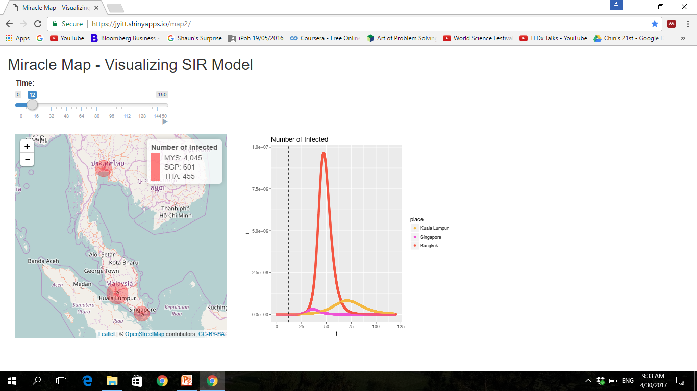
Disease Modeling : Webpage
Webpage Interface

Slide 7
Prospect: Application of the Disease Modeling
For SNS application,
The information on map provided includes:
Location on map (Country -> Region)
Red Zone – Infected Region
Orange Zone – High Risk Region
Green Zone – Safe Region
Estimate time to reach peak infected population
Information of the disease reported
Recommend precaution steps for user
Provide location of nearest medical facilities
May include quarantine zone and policy by government

Slide 8
Thank You!
☺

